Slide 1

Rich Internet Applications
Tommy Low

Slide 2
Topics
What is Rich Internet Applications (RIA)?
Introduction to HTML5 and CSS3
Compatibility checks
Demo Sites of RIA using HTML5 and CSS3
UI Frameworks, boilerplates and bootstraps

Slide 3
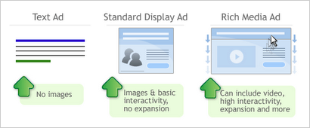
What is Rich Media?
rich media webpage contains images or video and involves some kind of user interaction.

Slide 4

What is Interactive Media?
Interactive media normally refers to products and services on digital computer-based systems which respond to the user’s actions by presenting content such as text, graphics, animation, video, audio, games, etc.
These content will engage the viewer in many levels, bringing the viewer close to a real experience.

Slide 5

Why Rich Interactive Media?
It brings user closer to the real experience.
It allows the user to engage with the business / owner
http://www.virtualtoursforhotels.com/
Notes:
Point 1
Example a Hotel website. You can view a hotel through images from a photo gallery, as well as a 360 view of the bedroom, or say a video clip of the
Beautiful beachfront of the hotel – you hear the waves, you see the colour of the ocean, or even fishes.
Point 2
For example, the user will be able to contact the booking conceirge through skype, or online chat.
They can also inquire or make a booking through interactive forms

Slide 6
What is Rich Internet Application?
A Rich Internet Application (RIA) is a Web application that has many of the characteristics of desktop application software, typically delivered by way of a site-specific browser, a browser plug-in, an independent sandbox, extensive use of JavaScript, or a virtual machine
Notes:
Examples:
An ad for a Hollywood movie that includes a streaming video sample of a scene from the movie

Slide 7
Evolution of HTML (5)
Show video here: http://www.youtube.com/watch?v=mzPxo7Y6JyA
Notes:
Online animated advertisment banners, photo galleries, interactive maps or forms are different kinds of rich media.

Slide 8
Introducing HTML5
HTML5 will be the new standard for HTML.
HTML5 is still a work in progress. However, the major browsers support many of the new HTML5 elements and APIs.
Some rules for HTML5 were established:
New features should be based on HTML, CSS, DOM, and JavaScript
More markup to replace scripting
The development process should be visible to the public
Reduce the need for external plugins (like Flash)
HTML5 should be device independent
Better error handling
Notes:
Web standards have advanced so much that it’s now possible to build almost anything using HTML, CSS, and JavaScript— almost anything.

Slide 9
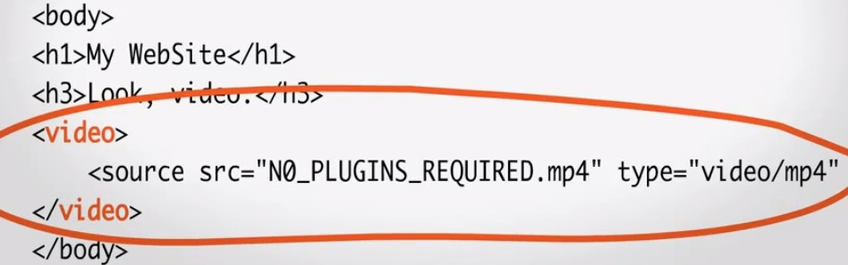
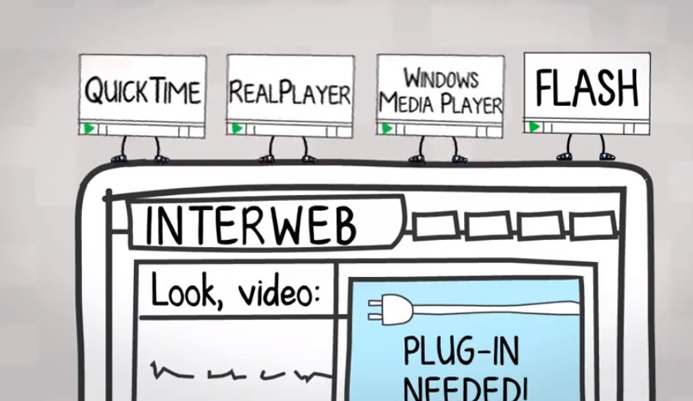
Why HTML5 ?
Mutuality - No Plug-ins required for video / audio
Notes:
Mutuality
Due to usability purpose the web sites made by developers are highly interactive nowadays and for this developers need to include fluid animations, stream video, play music and Social Network sites like Facebook and Twitter into the websites. Till now they have only the option to integrate it with the help of Flash or Silverlight, Flex or javascript like tools. But these consume so much time to develop and even the complexity of web application also increased. But now with the help of HTML5 it is possible to embed video and audio, high quality drawings, charts and animation and many other rich content without using any plugins and third party programmas as the functionality is built into the browser.
HTML5 introduce tags like <Video> so that plug ins will not be necessary.

Slide 10
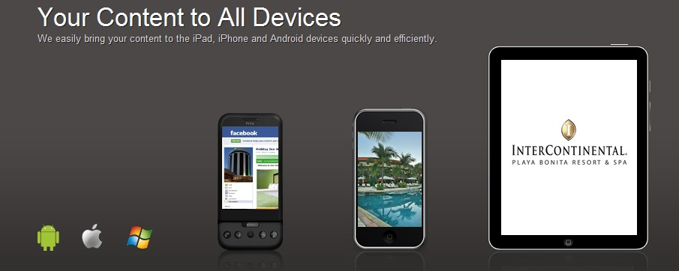
Why HTML5 ?
Platform & Device independent
Notes:
Device independent
HTML5 provides mobile device users richer web applications and improved usability. The new features of HTML5 standardize the use cases and technologies that are common in smartphone-optimized mobile web applications.
With HTML5 ,you can be accessing the same page from Andriod, Windows or Apple devices.

Slide 11
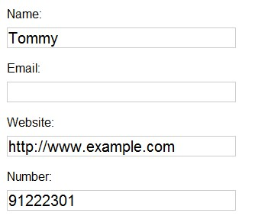
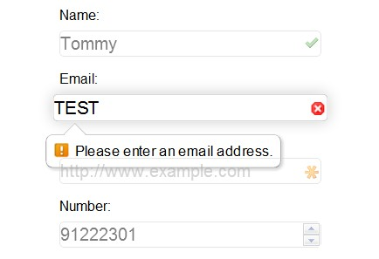
Why HTML5 ?
Elegant forms – Bulit in validation, customizable styling
Notes:
Elegant forms
HTML5 enables designer to use more fancier forms. Even it makes form validation native to HTML, User interface enhancements and reduced need for JavaScript (only needed in browsers that don’t support form types). There will be different type of text inputs, search and different fields for different purpose.
http://www.bradshawenterprises.com/tests/formdemo.php

Slide 12
Other Features of HTML5
New Elements
New Attributes
Full CSS3 Support
Video and Audio
2D/3D Graphics
Web Storage
Local SQL Database
Web Applications
Geolocation
Notes:
New Elements –
<article>Defines an article
<aside>Defines content aside from the page
<footer>Defines a footer for a document or section
<header>Defines a header for a document or
<nav>Defines navigation
<section>Defines a section in a document
It also include new Media Tags such as:
<audio>Defines sound content
<video>Defines a video or movie
<source>Defines multiple media resources for <video> and <audio>
Full CSS3 Support – which we will cover in a while.
Video and Audio – reduce need of plug ins.
2D/3D Graphics –
2d/3d graphics can be drawn using SVG or Canvas.
SVG is a language for describing 2D graphics in XML.
SVG is XML based, which means that every element is available within the SVG DOM. You can attach JavaScript event handlers for an element.
In SVG, each drawn shape is remembered as an object. If attributes of an SVG object are changed, the browser can automatically re-render the shape.
Canvas
Canvas draws 2D graphics, on the fly (with a JavaScript).
Canvas is rendered pixel by pixel.
In canvas, once the graphic is drawn, it is forgotten by the browser. If its position should be changed, the entire scene needs to be redrawn, including any objects that might have been covered by the graphic.
Local Storage
Local SQL Database
Web Applications

Slide 13
Other Features of HTML5
What is HTML5 Web storage
With HTML5, web pages can store data locally within the user's browser.
Earlier, this was done with cookies. However, Web Storage is more secure and faster. The data is not included with every server request, but used ONLY when asked for.

Slide 14
Other Features of HTML5
Geolocation
The HTML5 Geolocation API is used to get the geographical position of a user.
Since this can compromise user privacy, the position is not available unless the user approves it.
Example: http://html5demos.com/geo
Notes:
Example: http://html5demos.com/geo
With this, companies can locate stores and their services near you and make recommendations accordingly.

Slide 15
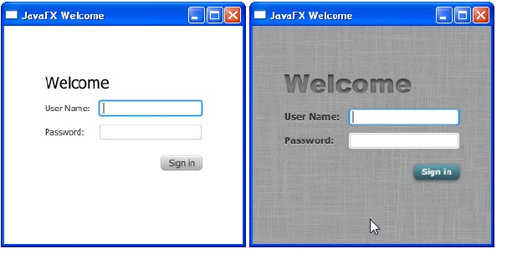
What is CSS / CSS3?
Cascading Style Sheets (CSS) is a style sheet language used for describing the presentation semantics (the look and formatting) of a document written in a markup language. Its most common application is to style web pages written in HTMLand XHTML.
CSS is used to control the style and layout of Web pages.
CSS3 is the latest standard for CSS.

Slide 16
What’s new in CSS3?
Just some of the many..
Border Radius & Border Images
Box Shadow
Multi-Column Layout
Multiple Backgrounds
@font-face
Opacity
Transformations
Transitions, animations
Check out w3schools.com for more
We will cover more in the weeks to come.
Notes:
EG.
Transitions:
With CSS3, we can add an effect when changing from one style to another, without using Flash animations or JavaScripts.
http://www.w3 schools.com/css3/css3_transitions.asp
Transformations
http://www.w3schools.com/css3/css3_3dtransforms.asp

Slide 17
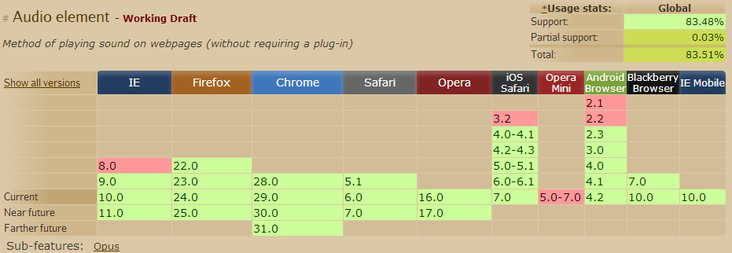
Compability Check
As HTML5/CSS3 are in development, we need to check if lower browser support certain new HTML5 tags/CSS3 properties/etc.
Compatibility tables for support of HTML5, CSS3, SVG and more in desktop and mobile browsers. This website will help you determine if the feature you use is widely compatible or not
  http://caniuse.com/
Notes:
Always check back this website for compatibility.

Slide 18
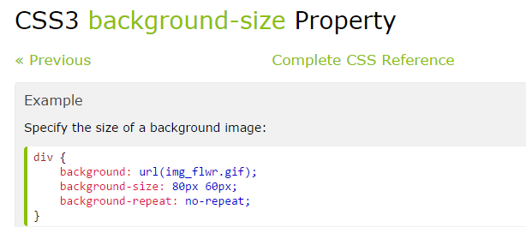
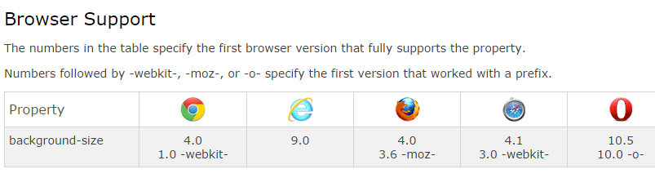
Compability Check
For example, in w3schools :
http://www.w3schools.com/cssref/css3_pr_background-size.asp
Under Brower support section for the background-size CSS3 property – you can see that some earlier browser versions need prefixes to be added to the CSS code in order for the CSS to work.
For example, I would like to use the CSS3 property background-size.
If the user is using Chrome 1.0 or earlier, I will need to type
webkit-background-size..
in order for it to work .
Notes:
Also you can check w3school for updates on different CSS3 properties and their support. Same goes for HTML5 tags. So check back often.

Slide 19
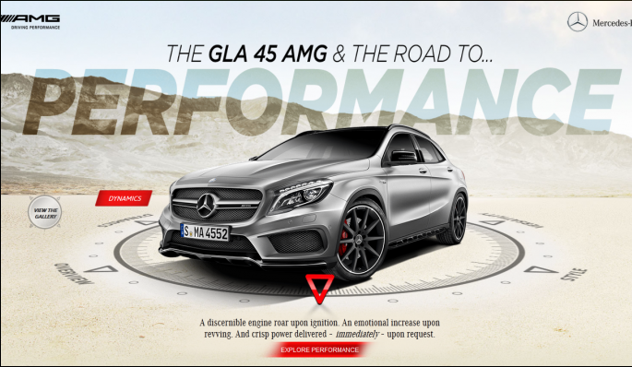
What can you achieve with HTML5 + CSS3 + Scripting?
Demo Sites:
https://www.mercedes-amg.com/en.html Interactive Website
http://html5-showcase.com/2014/02/flappy-bird/ - Game
http://www.designfever.com/ - interactive Website
Notes:
Click on each link (or picture) to demo the effects and site. Examine source behind using Inspect element on Chrome Browser

